Slide 1
CS60055: Ubiquitous Computing
Contactless Sensing
Part I: Sensing with RF: Basic Principles

Slide 2
Contactless Sensing
IMU-based sensing needs the subject to wear some devices: smartwatch, earable, smart glass, smart ring, …
  Might not be very convient all the times (ex. Sleep monitoring)
Contactless sensing are useful when the user does not want to attach the sensors with their body
  Useful for continuous and passive monitoring of human activities
  Widely used to monitor objects (materials, liquids, structures, ...)

Slide 3

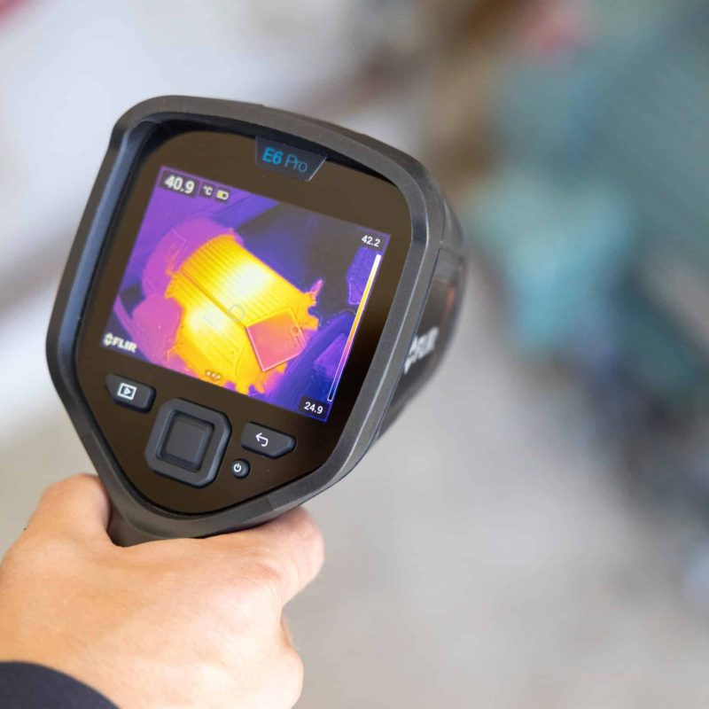
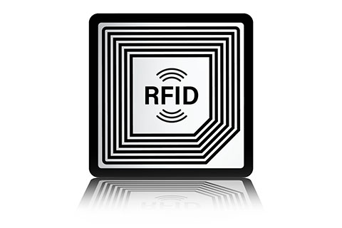
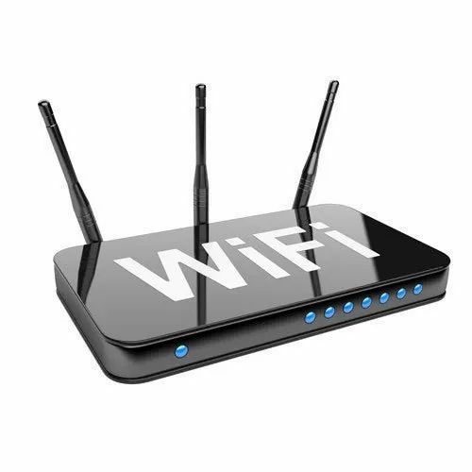

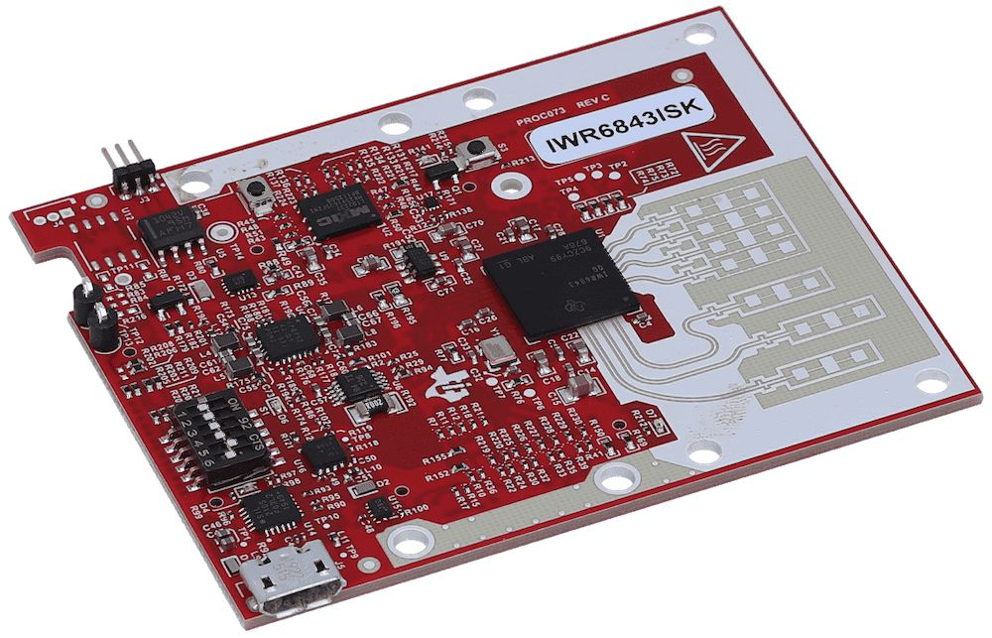
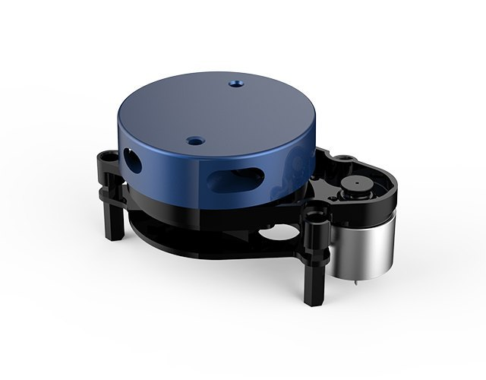
Sensing Modalities

Slide 4
Sensing Modalities
Primarily two modalities
  Electromagnetic waves (majority of the sensing devices work on some EM waves)
  Mechanical waves (acoustic-based sensing)
The basic operating principles vary depending on the type and the frequency of the waves being used in the sensing applications

Slide 5
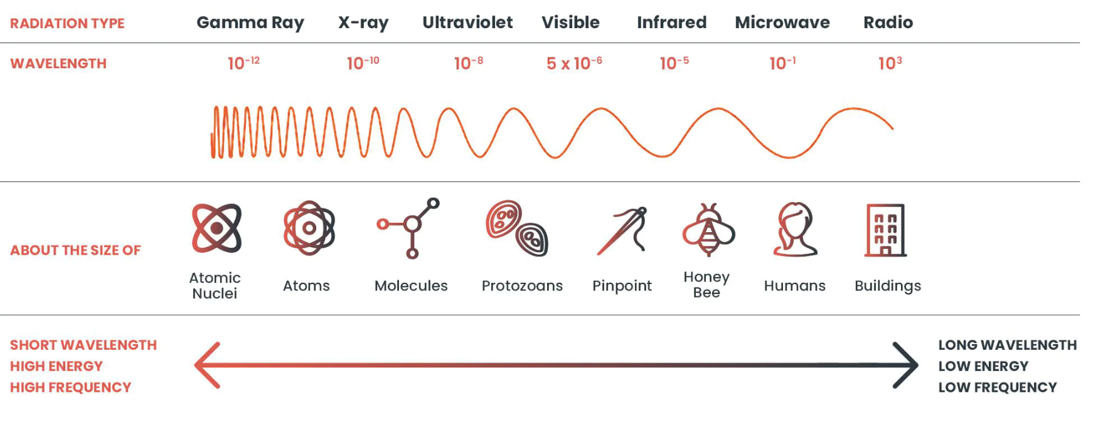
Fundamentals of EM Waves
The existence of EM was predicted by James Clerk Maxwell in 1864
  Heinrich Hertz confirmed the same in 1887
  Hertz also demonstrated that EM waves are affected and reflected by solid objects
The frequency and the wavelength characterizes the waves

Slide 6
Fundamentals of EM Waves
The existence of EM was predicted by James Clerk Maxwell in 1864
  Heinrich Hertz confirmed the same in 1887
  Hertz also demonstrated that EM waves are affected and reflected by solid objects
The frequency and the wavelength characterizes the waves
The objects we sense

Slide 7
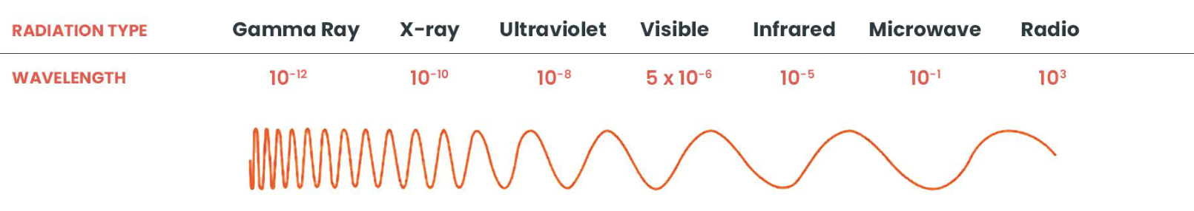
Fundamentals of EM Waves
The existence of EM was predicted by James Clerk Maxwell in 1864
  Heinrich Hertz confirmed the same in 1887
  Hertz also demonstrated that EM waves are affected and reflected by solid objects
The frequency and the wavelength characterizes the waves
  Long wavelength, low frequency: Penetrate more through physical objects
  Medium wavelength, medium frequency: Reflect more from physical objects
  Short wavelength, high frequency: Penetrate more through the objects
Penetrate more
Penetrate more
Reflect more

Slide 8
Fundamentals of EM Waves
The existence of EM was predicted by James Clerk Maxwell in 1864
  Heinrich Hertz confirmed the same in 1887
  Hertz also demonstrated that EM waves are affected and reflected by solid objects
The frequency and the wavelength characterizes the waves
  Long wavelength, low frequency: Penetrate more through physical objects
  Medium wavelength, medium frequency: Reflect more from physical objects
  Short wavelength, high frequency: Penetrate more through the objects
This is just a general idea; the penetration/reflection capability of the signal also depends on its bandwidth and other channel parameters
Penetrate more
Penetrate more
Reflect more

Slide 9
Fundamentals of EM Waves
The existence of EM was predicted by James Clerk Maxwell in 1864
  Heinrich Hertz confirmed the same in 1887
  Hertz also demonstrated that EM waves are affected and reflected by solid objects
The frequency and the wavelength characterizes the waves
  Long wavelength, low frequency: Penetrate more through physical objects
  Medium wavelength, medium frequency: Reflect more from physical objects
  Short wavelength, high frequency: Penetrate more through the objects
Useful for passive contactless sensing
Penetrate more
Penetrate more
Reflect more

Slide 10
Fundamentals of EM Waves
The existence of EM was predicted by James Clerk Maxwell in 1864
  Heinrich Hertz confirmed the same in 1887
  Hertz also demonstrated that EM waves are affected and reflected by solid objects
The frequency and the wavelength characterizes the waves
  Long wavelength, low frequency: Penetrate more through physical objects
  Medium wavelength, medium frequency: Reflect more from physical objects
  Short wavelength, high frequency: Penetrate more through the objects
Used widely for sensing, but privacy is a concern
(the vision domain)
Penetrate more
Penetrate more
Reflect more

Slide 11
Fundamentals of EM Waves
The existence of EM was predicted by James Clerk Maxwell in 1864
  Heinrich Hertz confirmed the same in 1887
  Hertz also demonstrated that EM waves are affected and reflected by solid objects
The frequency and the wavelength characterizes the waves
  Long wavelength, low frequency: Penetrate more through physical objects
  Medium wavelength, medium frequency: Reflect more from physical objects
  Short wavelength, high frequency: Penetrate more through the objects
Analyze the signal reflection properties for the long wavelength signals
Penetrate more
Penetrate more
Reflect more

Slide 12
Fundamentals of EM Waves
The existence of EM was predicted by James Clerk Maxwell in 1864
  Heinrich Hertz confirmed the same in 1887
  Hertz also demonstrated that EM waves are affected and reflected by solid objects
The frequency and the wavelength characterizes the waves
  Long wavelength, low frequency: Penetrate more through physical objects
  Medium wavelength, medium frequency: Reflect more from physical objects
  Short wavelength, high frequency: Penetrate more through the objects
Analyze the signal penetration properties for the short wavelength signals
Analyze the signal reflection properties for the long wavelength signals
Penetrate more
Penetrate more
Reflect more

Slide 13
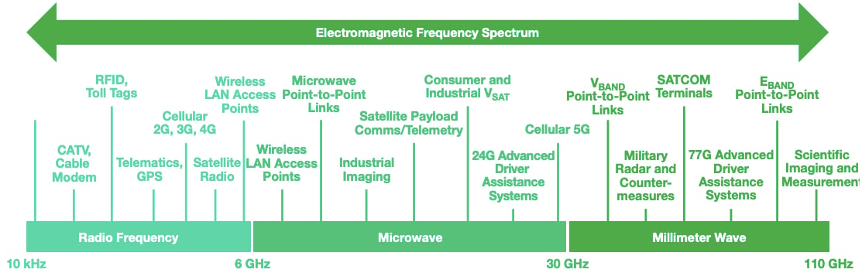
Radio Waves
Image Source: https://www.allaboutcircuits.com/technical-articles/basics-of-millimeter-wave-mmwave-technology/

Slide 14
Radio Waves
We'll see sensing applications in these ranges
RFID
WiFi
UWB
mmWave
Image Source: https://www.allaboutcircuits.com/technical-articles/basics-of-millimeter-wave-mmwave-technology/

Slide 15
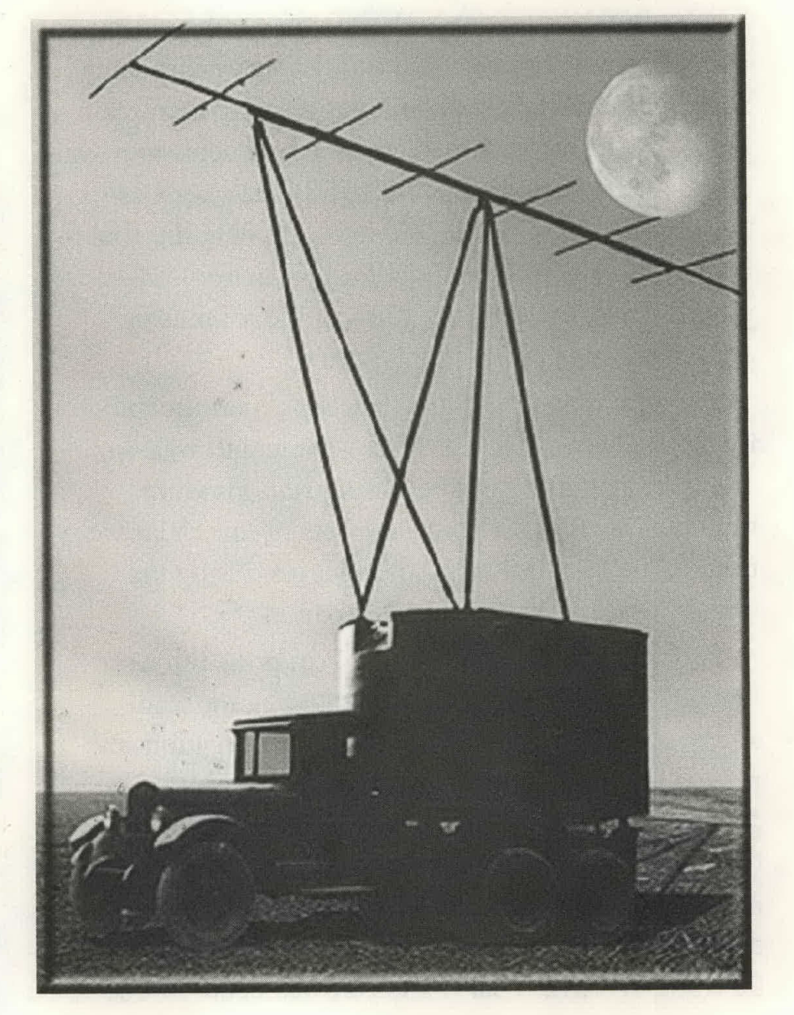
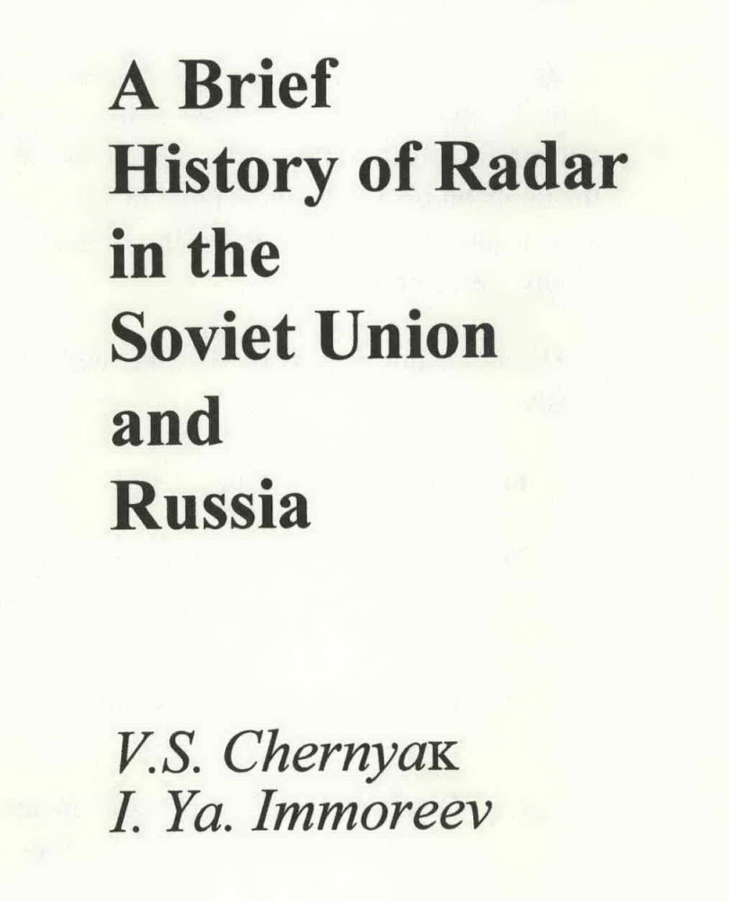
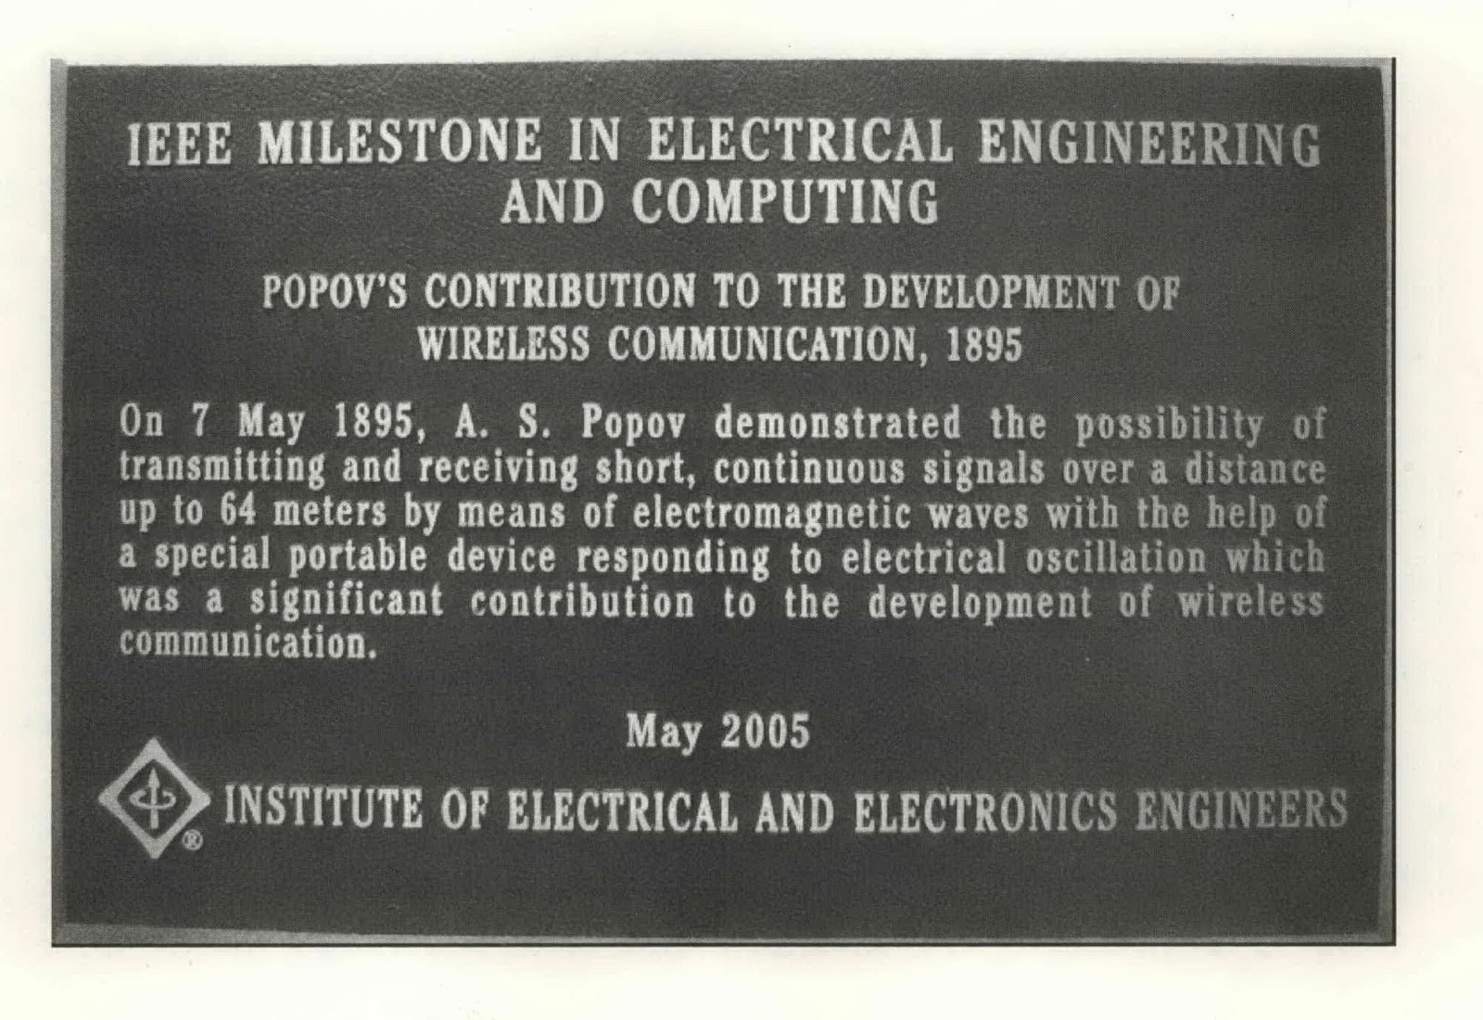
Signal Interference to Detect Motion: The Concept of Radar
1897: Alexander Popov, a Russian Imperial Navi physicist, was testing an early version of wireless communication between two ships in Baltic Sea
  He observed an interference wave pattern caused by a third ship
  Popov proposed the idea that this might be used to detect moving objects
https://ieeexplore.ieee.org/abstract/document/5282288

Slide 16
Signal Interference to Detect Motion: The Concept of Radar
1932: Radar as a technical equipment was proposed by a military engineer Piotr Oshchepkov
  "RUS-1": The first industrial radar (1939): 4m wavelength, transmitter and receiver seperated by 35 km
https://ieeexplore.ieee.org/abstract/document/5282288

Slide 17

Basic Principle: The Doppler Effect
Change in the frequency of the wave in relation to an observer who is moving relative to the wave source
  Wave source moves towards the observer: Each successive wave cycle is emitted from a position closer to the observer
    Time between cycles is reduced; frequency is increased
  Wave source moves away from the observer: Each successive wave cycle is emitted from a position farther from the observer
    Time between cycles is increased; frequency is decreased
Image Source: Wikipedia

Slide 18
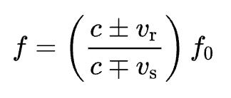
The Doppler Effect
Let,
  f₀ is the emitted frequency
  f is the observed frequency
  c is the propagation speed of the wave in the medium
  𝑣_{r} is the speed of the receiver, 𝑣_{s} is the speed of the source
𝑣_{r} is added to 𝑐 if the receiver is moving towards the source, subtracted if the receiver is moving away from the source (opposite for 𝑣_{s})

Slide 19
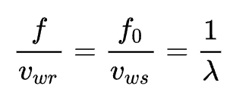
The Doppler Effect
Equivalently, if the source is directly approaching or receding from the observer,
  𝑣_{wr} is the wave speed related to the receiver, 𝑣_{ws} is the wave speed related to the source
  λ is the wavelength

Slide 20
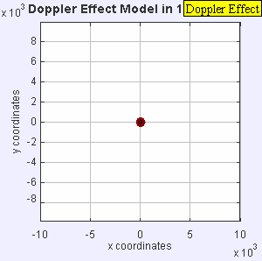
Doppler Effect for the Sound Sources
Stationary sound source
Image Source: Wikipedia

Slide 21
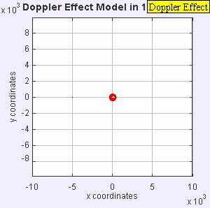
Doppler Effect for the Sound Sources
Stationary sound source
Source moves at a speed 0.7c
Image Source: Wikipedia

Slide 22
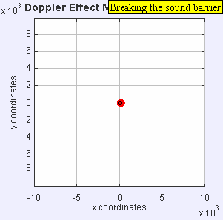
Doppler Effect for the Sound Sources
Stationary sound source
Source moves at a speed 0.7c
Source moves at a speed c
Image Source: Wikipedia

Slide 23
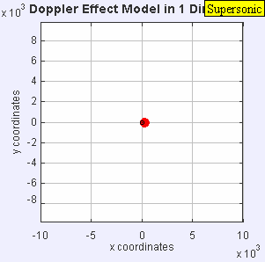
Doppler Effect for the Sound Sources
Advancing wavefront
Creates a shock wave and consequently the sonic boom
Source moves at a speed 1.4c
Image Source: Wikipedia

Slide 24
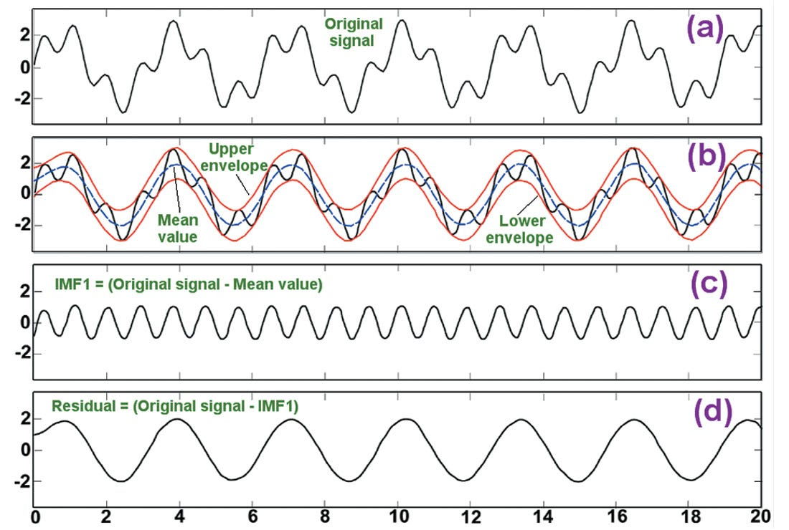
The Wave: Concept of Bandwidth
Any arbitrary wave signal can be decomposed into a set of sinusoidal wave of multiple frequencies
  Called the frequency components of the wave signal (or simply, the signal)
Image Source:https://towardsdatascience.com/decomposing-signal-using-empirical-mode-decomposition-algorithm-explanation-for-dummy-93a93304c541

Slide 25
The Wave: Concept of Bandwidth
Any arbitrary wave signal can be decomposed into a set of sinusoidal wave of multiple frequencies
  Called the frequency components of the wave signal (or simply, the signal)
The bandwidth of a signal is the
difference between the highest and
the lowest frequency components
of that signal
  We assume that any of the frequency
  components between the highest
  and the lowest can be present in
  the signal

Slide 26
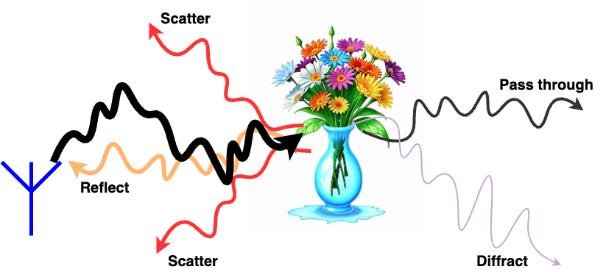
Impact of Bandwidth on Sensing
Higher bandwidth signal means it is likely to have more number of signal components
  Therefore, scattering, diffraction, reflection, etc., are likely to be more on high-bandwidth signals

Slide 27
Impact of Bandwidth on Sensing
Higher bandwidth signal means it is likely to have more number of signal components
  Therefore, scattering, diffraction, reflection, etc., are likely to be more on high-bandwidth signals
Although create noises for communication, but good for sensing

Slide 28
Impact of Bandwidth on Sensing
Higher bandwidth signal means it is likely to have more number of signal components
  Therefore, scattering, diffraction, reflection, etc., are likely to be more on high-bandwidth signals
Although create noises for communication, but good for sensing
How do we get the various frequency components of a signal?

Slide 29
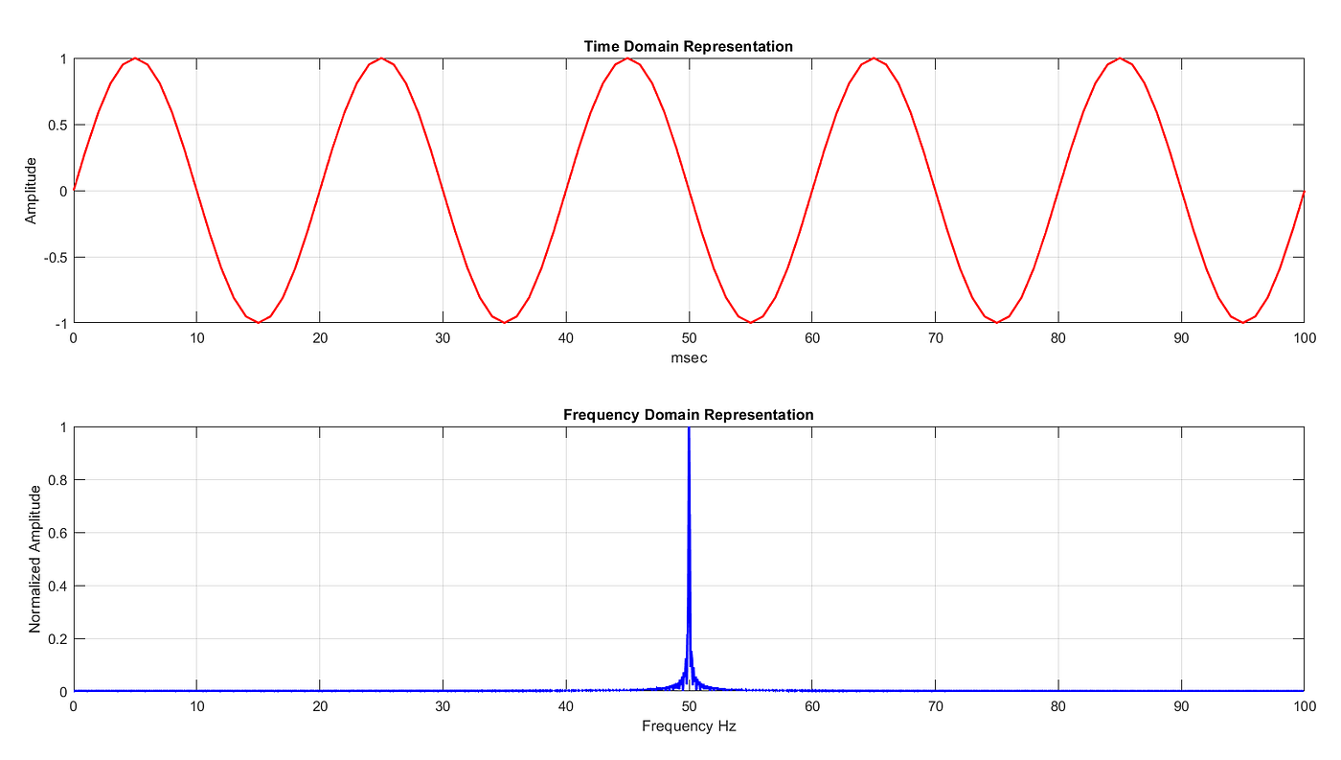
Fourier Analysis
Extracts the frequency components of a signal

Slide 30
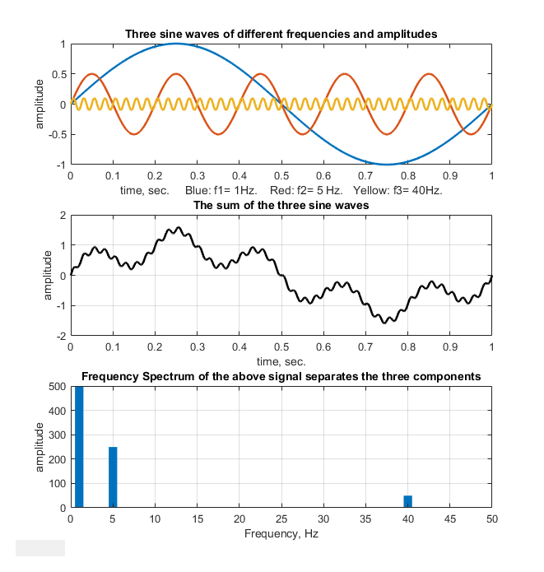
Fourier Analysis
Extracts the frequency components of a signal

Slide 31
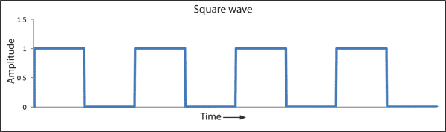
Fourier Analysis
Extracts the frequency components of a signal

Slide 32
Fourier Analysis
Extracts the frequency components of a signal

Slide 33
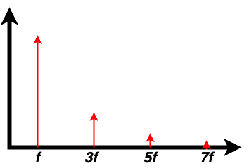
Fourier Analysis
Extracts the frequency components of a signal

Slide 34
Fourier Analysis
Extracts the frequency components of a signal

Slide 35
Fourier Analysis
Extracts the frequency components of a signal
How do we perform Fourier Analysis of a complex signal?

Slide 36
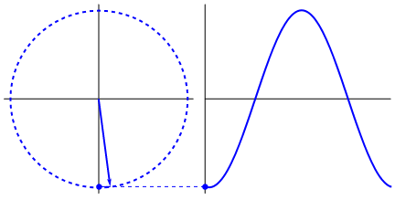
Representation of a Signal
y(t) = A sin (ωt + φ)
A: Amplitude
ω: Angular frequency
φ: Phase
What is the significance of frequency of this signal?

Slide 37
Fourier Representation in Complex Domain
y(t) = A sin (2πft + φ)
A: Amplitude
f: Ordinary frequency
φ: Phase

Slide 38
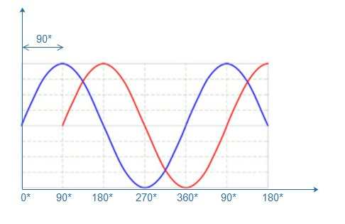
The Notion of Phase
The fraction of the cycle covered upto some time instance t
An important metric for sensing
  The phase of the reflected/scattered signal depends on the type of the material where the transmitted signal hitted
  Introduces a shift in the reflected/scattered signal

Slide 39
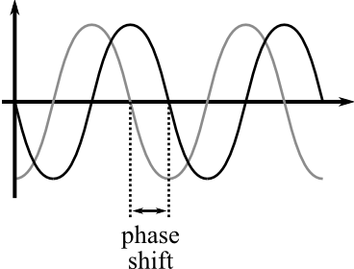
The Notion of Phase
The fraction of the cycle covered upto some time instance t
An important metric for sensing
  The phase of the reflected/scattered signal depends on the type of the material where the transmitted signal hitted
  Introduces a shift in the reflected/scattered signal
Phase difference/phase shift:

Slide 40
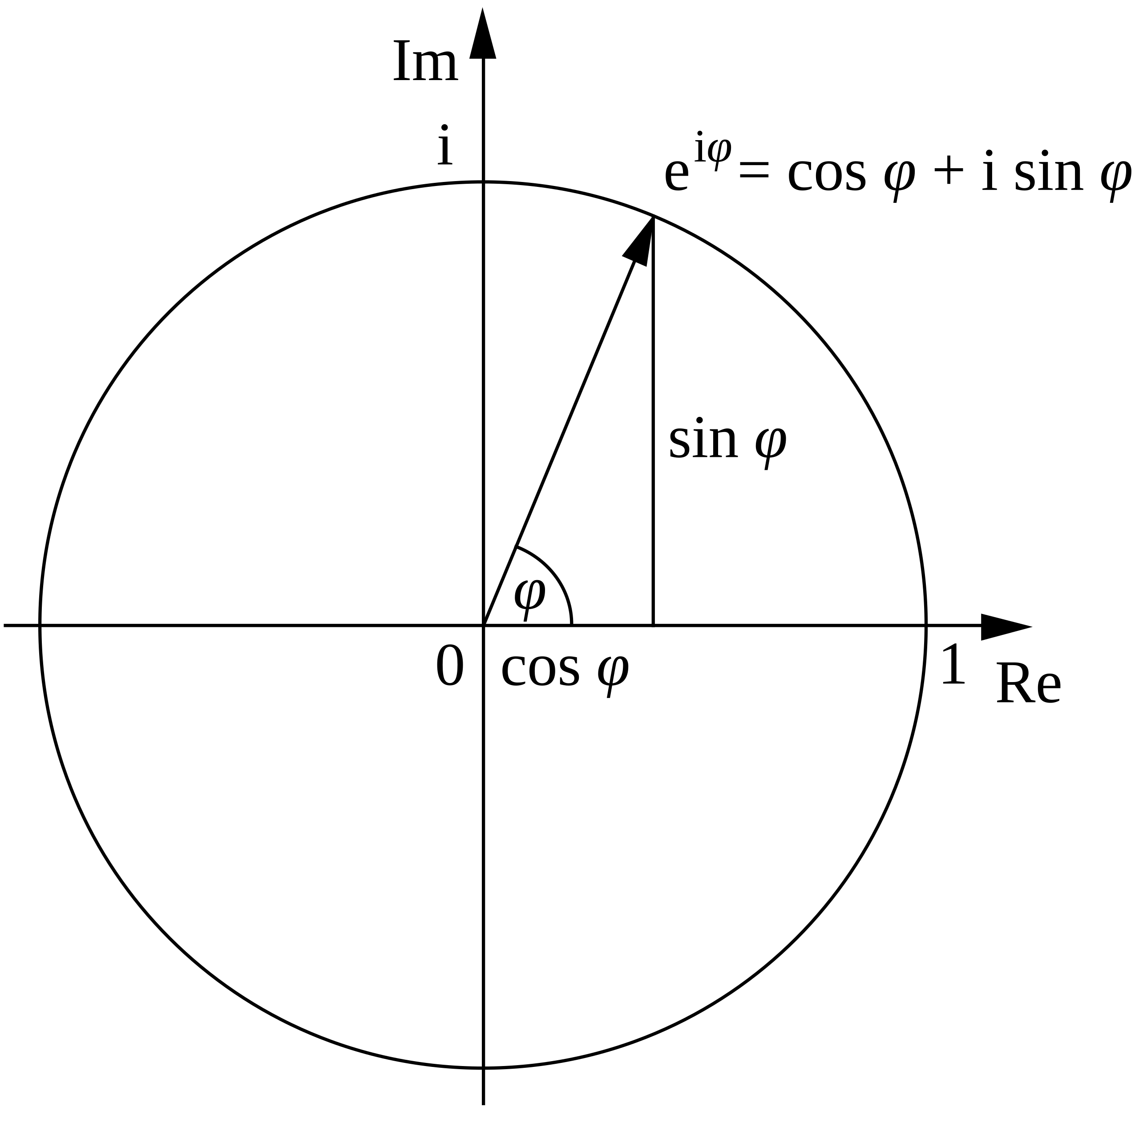
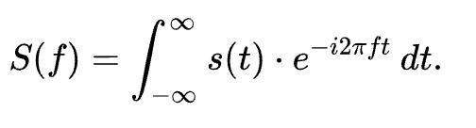
Fourier Representation in Complex Domain

Slide 41

Fourier Representation in Complex Domain
Check this video for a nice explanation of Fourier transformation

Slide 42
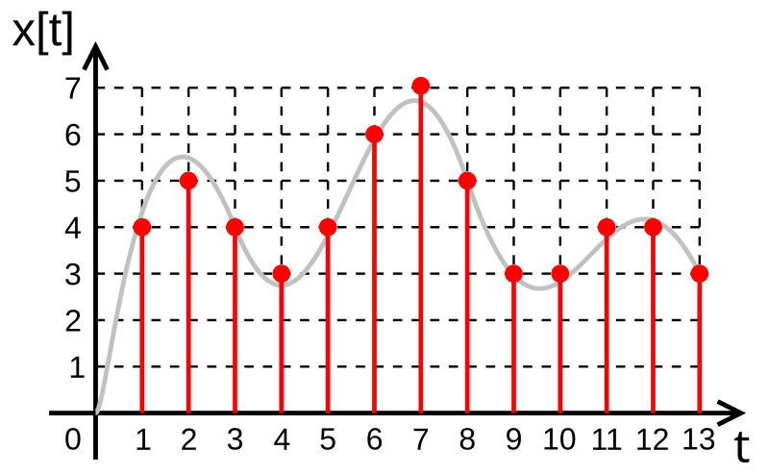
Discrete Fourier Transformation
In practice, we record the samples of a continuous signal
  Discrete representation of the signal
So, we need to perform the Fourier
transformation on the discrete samples
of the signals
  Discrete Time Fourier Transform (DTFT)
However, the input and the output of
the samples are also finite
  Discrete Fourier Transform (DFT): Works on the finite time series data

Slide 43
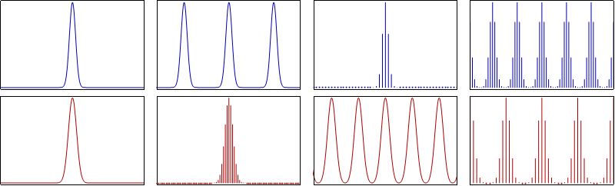
DTFT and DFT
A Continuous signal and its Fourier transform
Periodic summation of the original signal and its Fourier transform
Original signal discretized and its Fourier transform (DTFT)
Periodic summation of the discrete signal, DFT computes discrete samples of the continuous DTFT
Image Source: Wikipedia

Slide 44

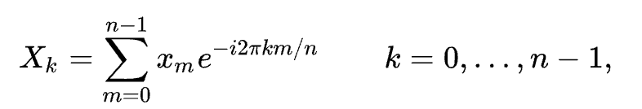

Discrete Fourier Transformation (DFT)
Let be complex numbers. The DFT is defined by the formula,
  Where is the primitive n^{th} root of 1
Evaluating the above equation needs O(n²) operations

Slide 45
Discrete Fourier Transformation (DFT)
Let be complex numbers. The DFT is defined by the formula,
  Where is the primitive n^{th} root of 1
Evaluating the above equation needs O(n²) operations

Slide 46

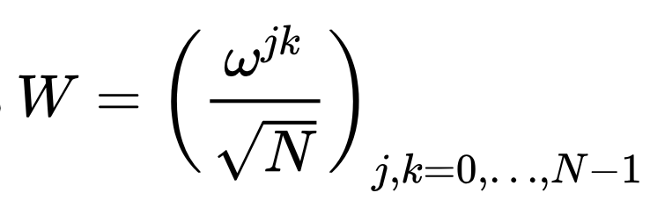

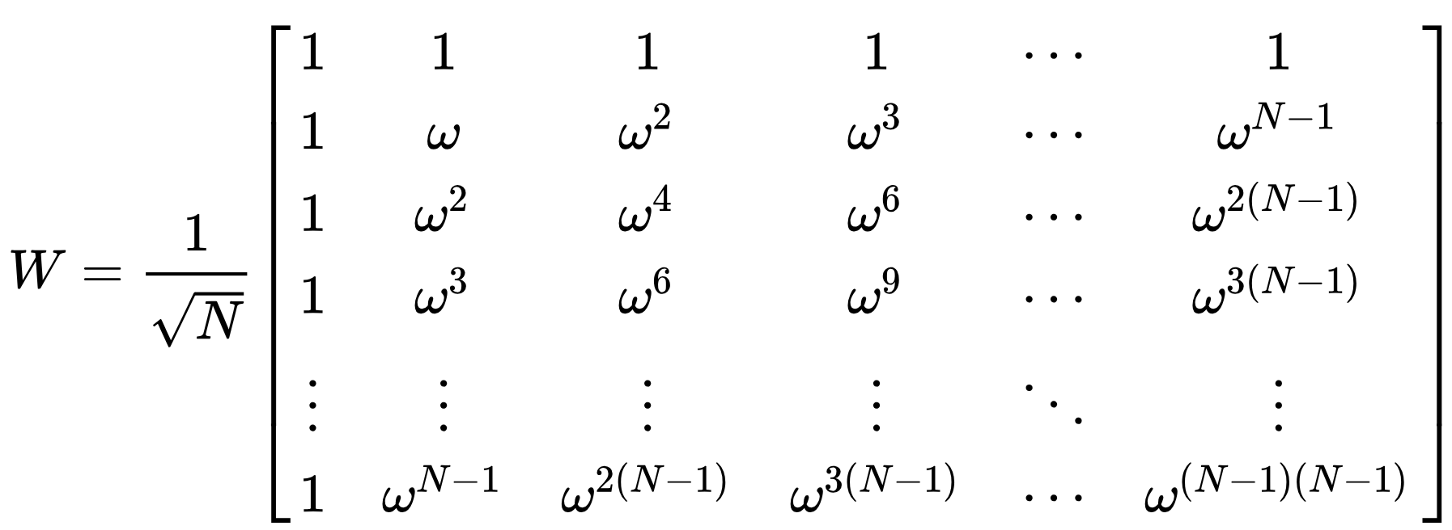
DFT Matrix
An N-point DFT is represented as
  x is the original input signal
  W is NxN DFT matrix
  ω is a primitive N^{th} root of unity
For different values of j, W can be
represented as a matrix

Slide 47
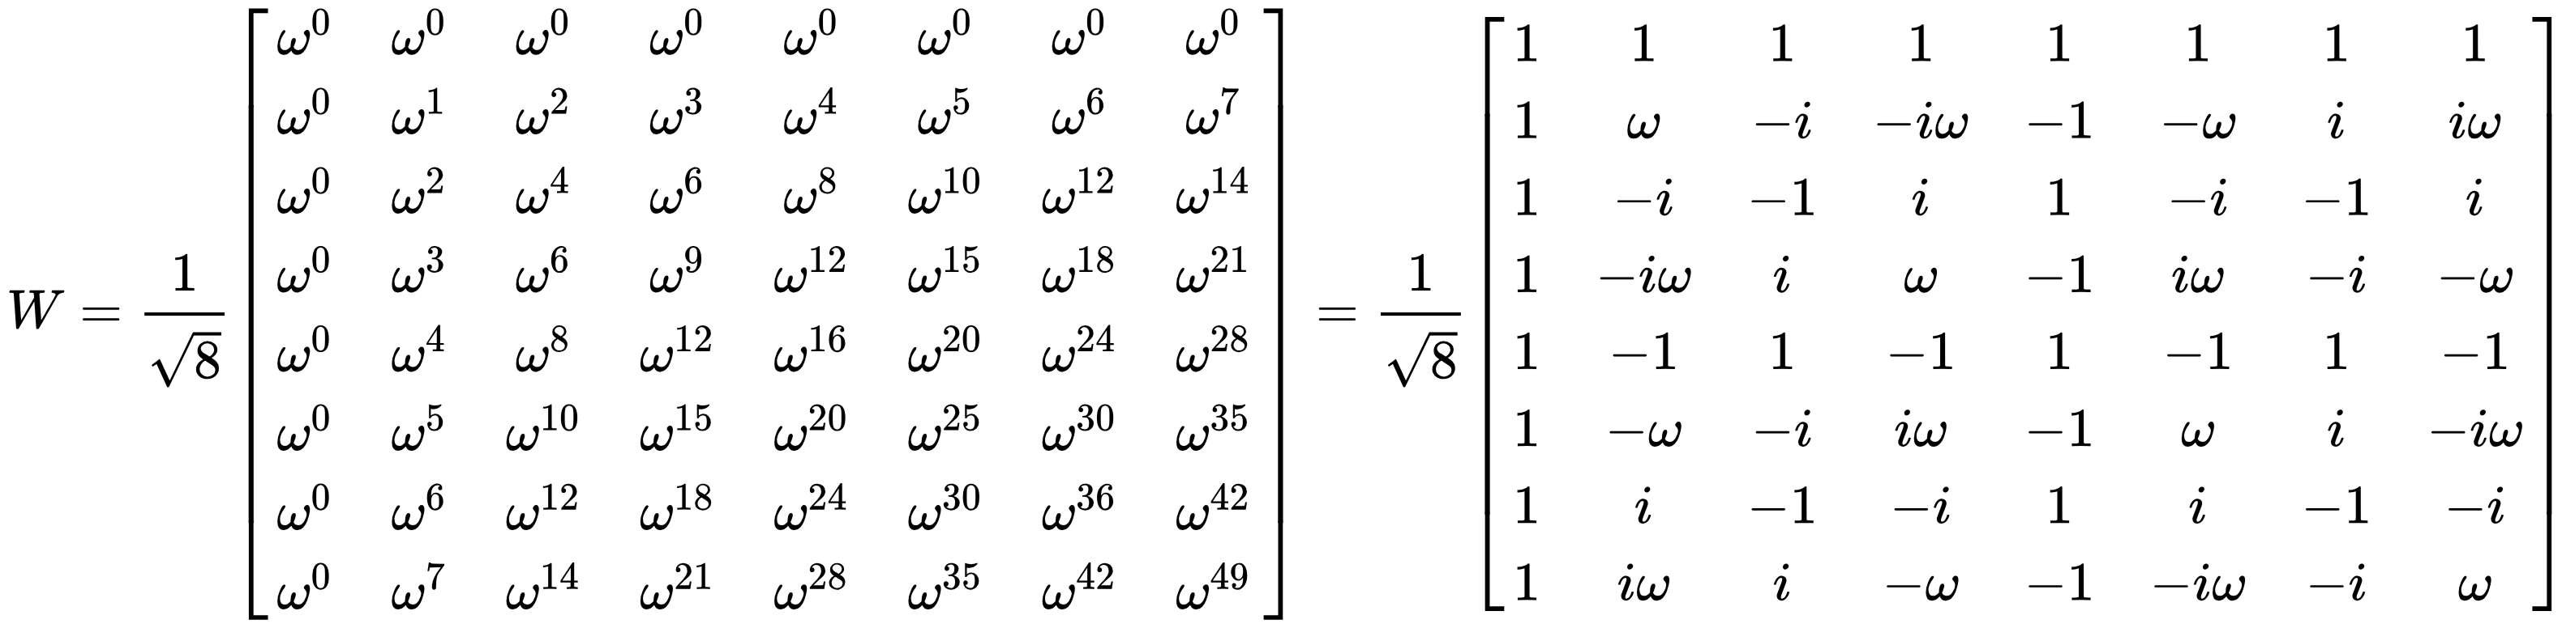
Example: 8-point DFT

Slide 48
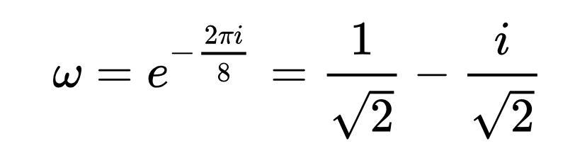
Example: 8-point DFT

Slide 49
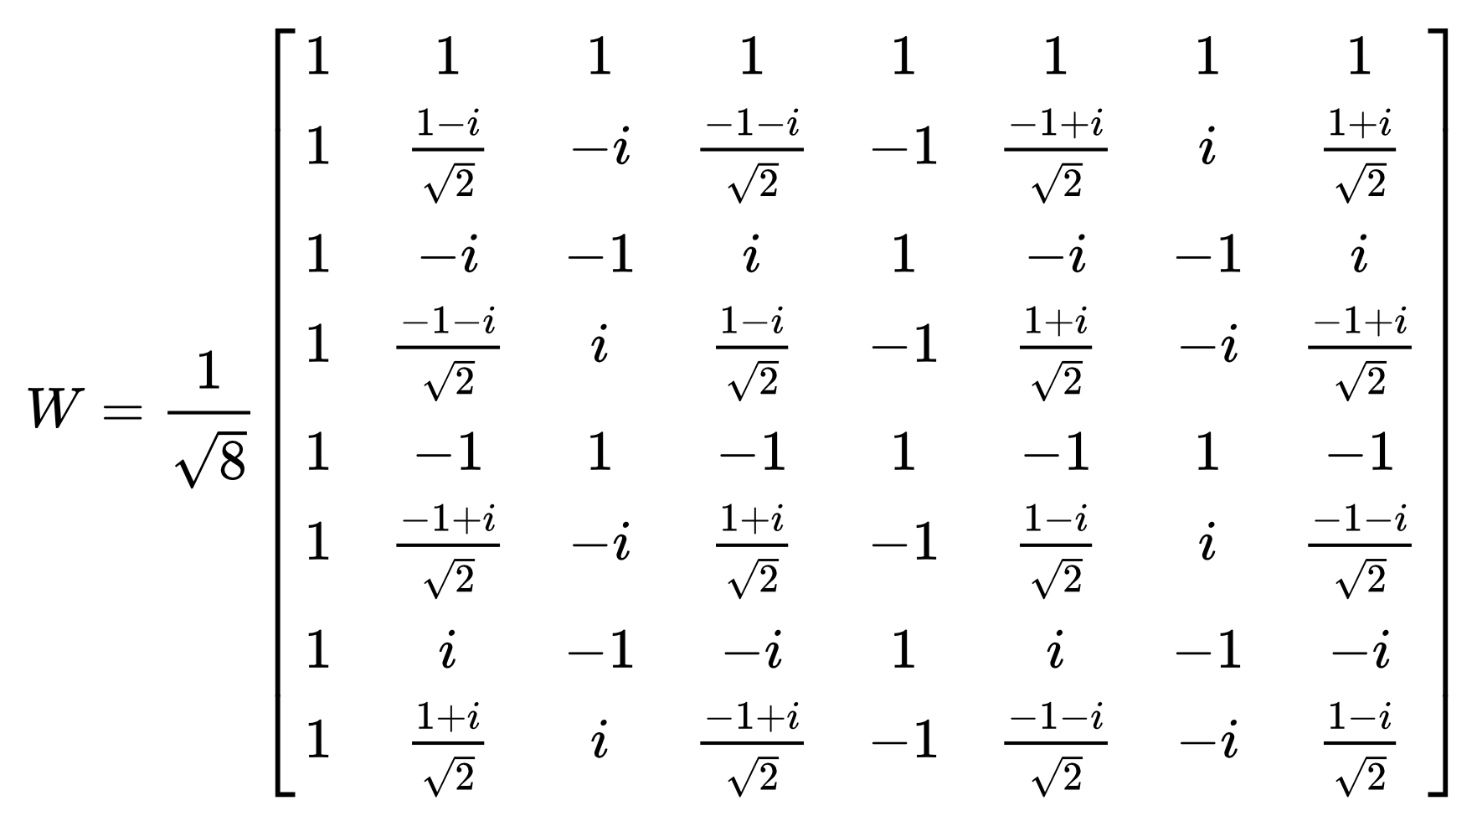
Example: 8-point DFT

Slide 50
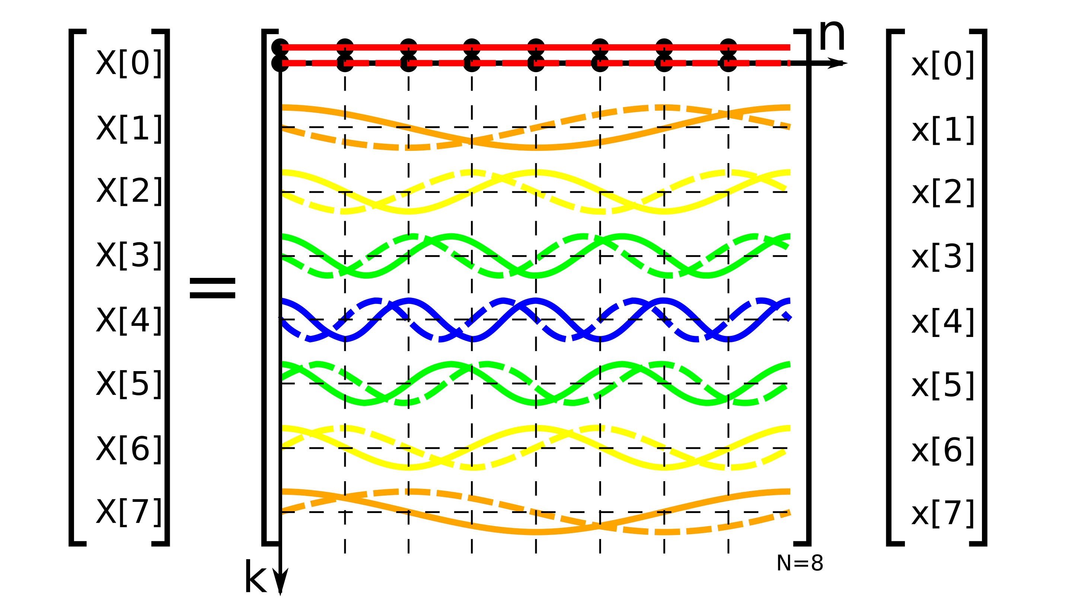
Example: 8-point DFT: Pictorial Representation
Cosine wave: Solid Line
Sine wave: Dashed line

Slide 51
Example: 8-point DFT: Pictorial Representation
DC Component
Cosine wave: Solid Line
Sine wave: Dashed line

Slide 52
Example: 8-point DFT: Pictorial Representation
Fractional frequency +1/8
Cosine wave: Solid Line
Sine wave: Dashed line

Slide 53
Example: 8-point DFT: Pictorial Representation
Fractional frequency +1/4
Cosine wave: Solid Line
Sine wave: Dashed line

Slide 54
Example: 8-point DFT: Pictorial Representation
Fractional frequency +3/8
Cosine wave: Solid Line
Sine wave: Dashed line

Slide 55
Example: 8-point DFT: Pictorial Representation
Fractional frequency +5/8
Cosine wave: Solid Line
Sine wave: Dashed line

Slide 56
Example: 8-point DFT: Pictorial Representation
Fractional frequency +5/8
or –3/8
cos (2π - φ) = cos φ
sin (2π - φ) = -sin φ
Cosine wave: Solid Line
Sine wave: Dashed line

Slide 57
Example: 8-point DFT: Pictorial Representation
Fractional frequency +3/4
or –1/4
Cosine wave: Solid Line
Sine wave: Dashed line

Slide 58
Example: 8-point DFT: Pictorial Representation
Fractional frequency +7/8
or –1/8
Cosine wave: Solid Line
Sine wave: Dashed line

Slide 59
Discrete Fourier Transformation (DFT)
Let be complex numbers. The DFT is defined by the formula,
  Where is the primitive n^{th} root of 1
Evaluating the above equation needs O(n²) operations
Can we reduce the complexity?

Slide 60
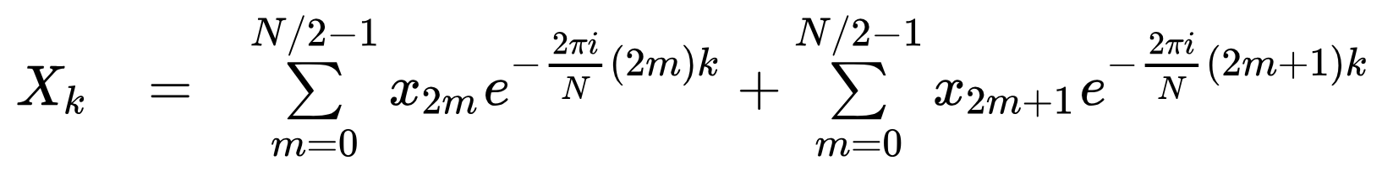
Fast Fourier Transform (FFT)
Divide the DFT matrix recursively into smaller DFTs and then combine them
  Based on the multiplications on complex root of unity
Radix-2 decimation-in-time (DIT) FFT
  Divide between odd and even inputs

Slide 61
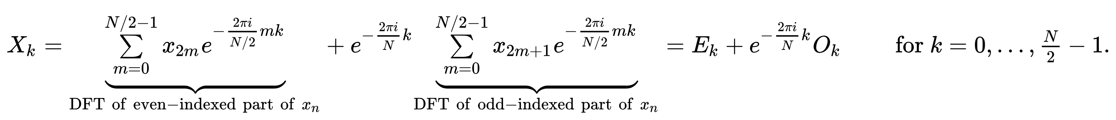
Fast Fourier Transform (FFT)
Divide the DFT matrix recursively into smaller DFTs and then combine them
  Based on the multiplications on complex root of unity
Radix-2 decimation-in-time (DIT) FFT
  Divide between odd and even inputs
  By rearranging,

Slide 62
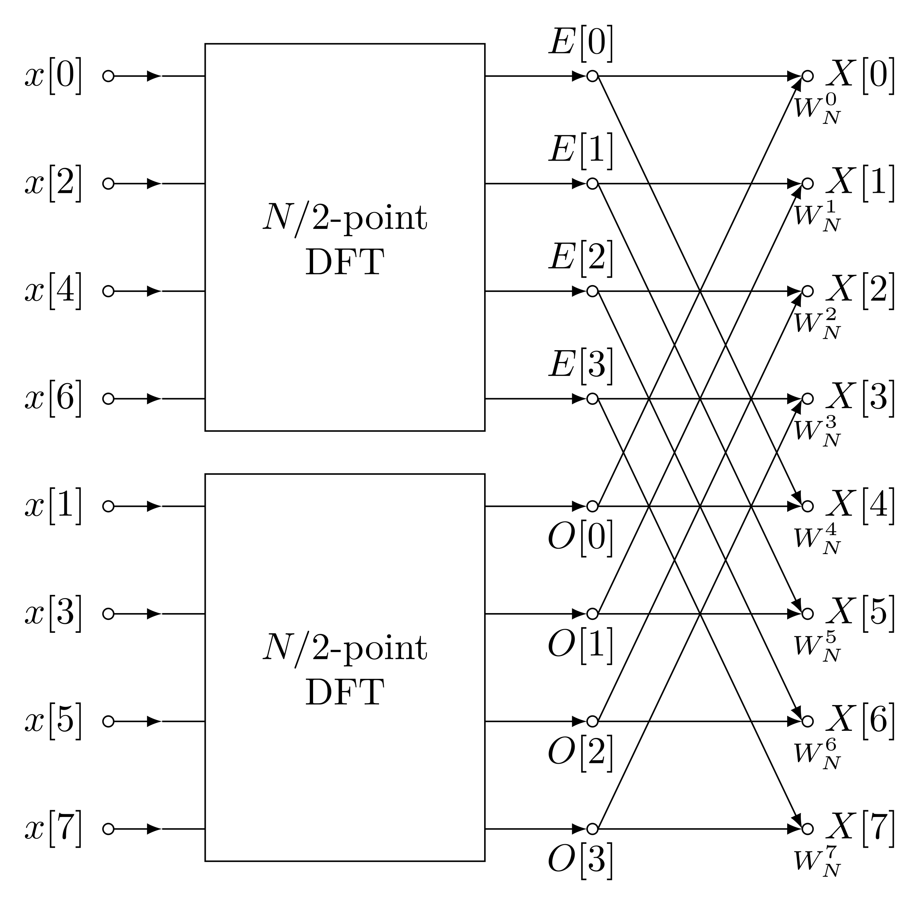
FFT for N = 8

Slide 63
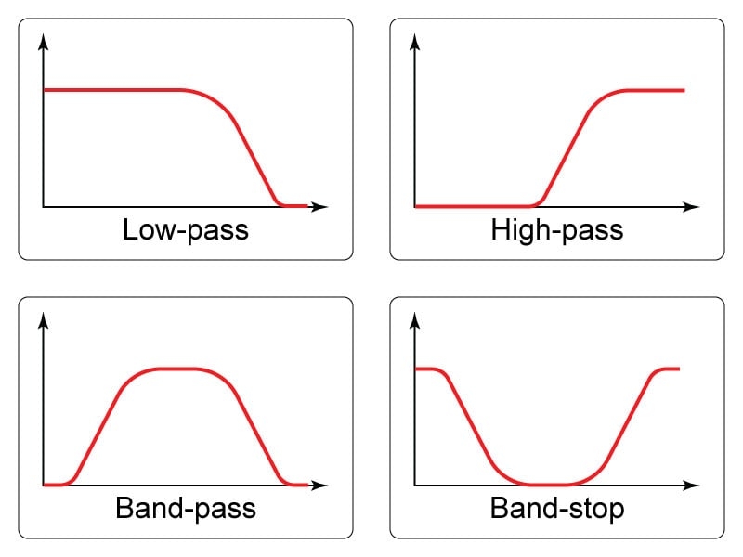
Application of FFT in Sensing -- Filters
Extract a portion of the signal components
Example: Acoustic data processing
  You want to analyze the acoustic chirp
  sent from your smartphone
  However, the sound emitted may get
  mixed with other environmental
  noises
  Pass the received signal through a
  band-pass filter to extract only the
  components of the target frequency
  band

Slide 64
In Summary
Signal propagation, distortion, reflection, etc., can help us sense the environment
  Doppler analysis helps in identifying moving objects or movement patters
  The reflection patterns (frequency components, time of flight, etc.) can be used to compute the distance of the object from the transmitter, angle of arrival, etc.
  Phase shift can be used to identify material properties
Fourier transform helps us to identify the frequency components in the signal
  Helpful for signal analysis (we'll see the details later)
  Useful for preprocessing the signals – removing unwanted signal components – low-pass/ high-pass/ bandpass filters

Slide 65




Happy Learning!
Some resources related to this topic

